Slide 1
Speed Controller
of
Dc Motor

Slide 2
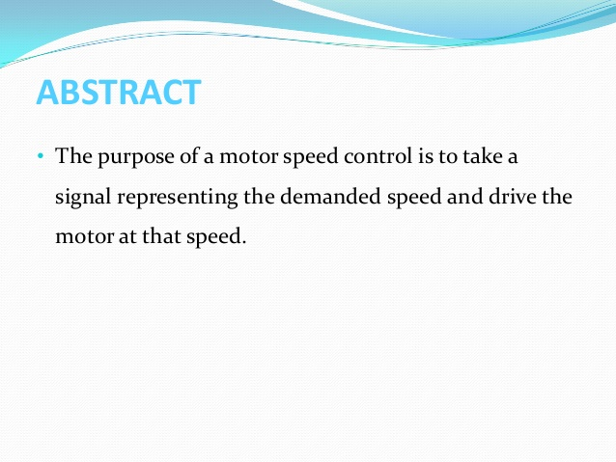

Slide 3
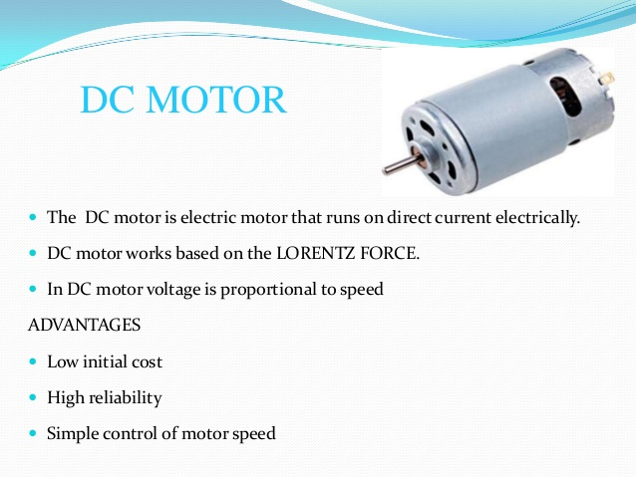

Slide 4
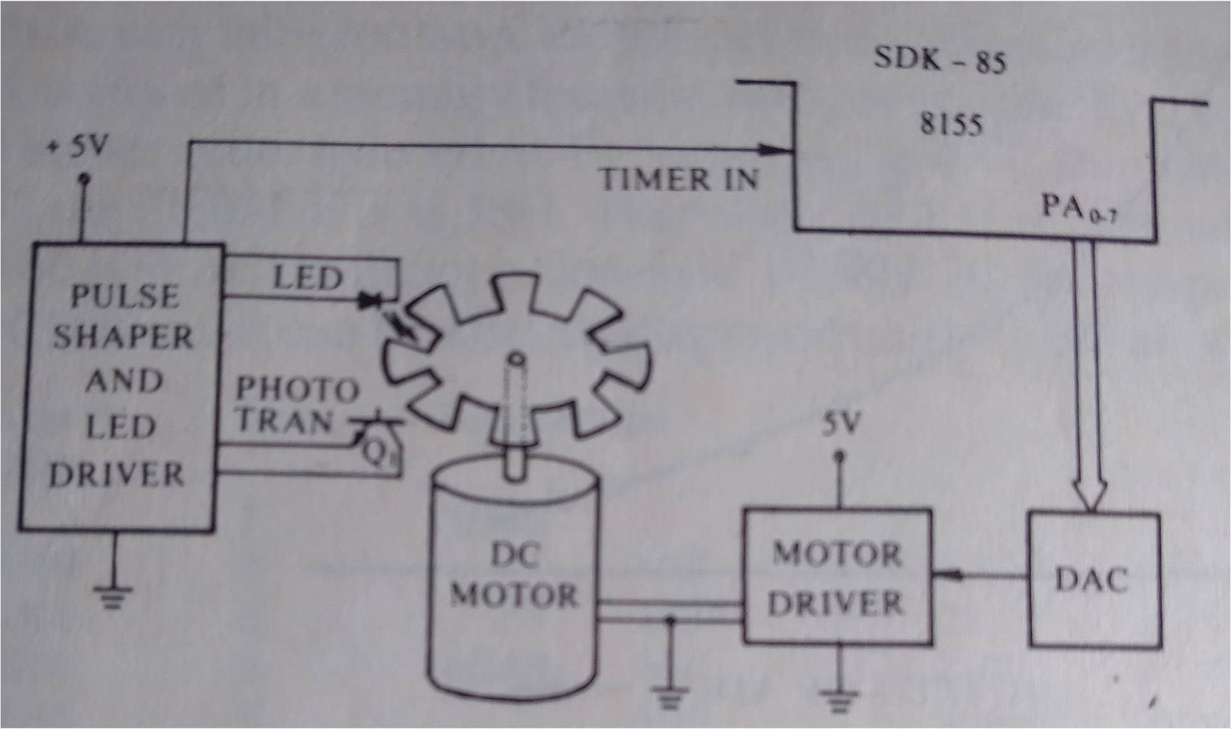
Speed Control of DC Motor
Figure: Block Diagram of the Circuit used for the Control of Speed of DC Motor
Necessary Hardware:
I/O Port and Timer/Counter
DAC and the Current Amplifier
Pulse Shaper and LED Driver

Slide 5
Software Design
Step 1: Read the Desired Speed REQD from the Keyboard…
Step 2: Choose Initial DATA to be applied to DAC to start Motor
Step 3: Apply DATA to DAC through Port A
Step 4: Generate delay to attain stable speed
Step 5: Measure the speed of the DC Motor MESD
Step 6: Compare MESD with REQD. IF MESD = REQD then go to Step 7
If MESD > REQD then decrement DATA by 1; else increment DATA by 1
go to Step 7
Step 7: Save modified DATA, display MESD
Step 8: Go to Step 3

Slide 6
AT89c51-Microcontroller Based Speed Controller of DC Motors

Slide 7
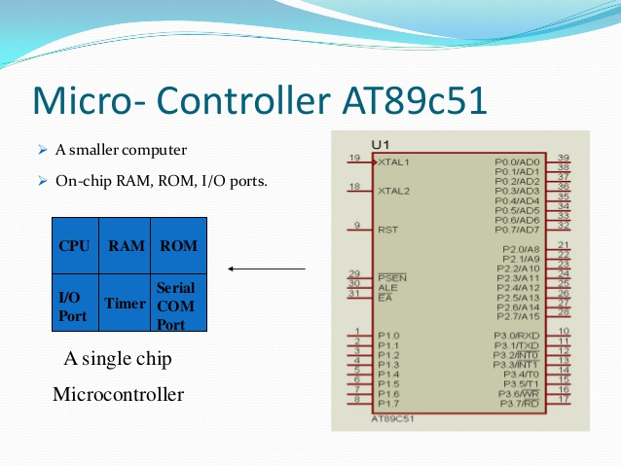

Slide 8
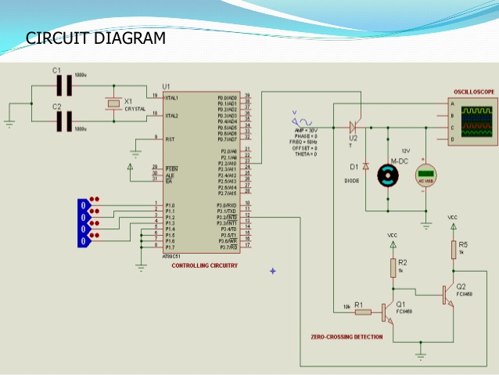

Slide 9
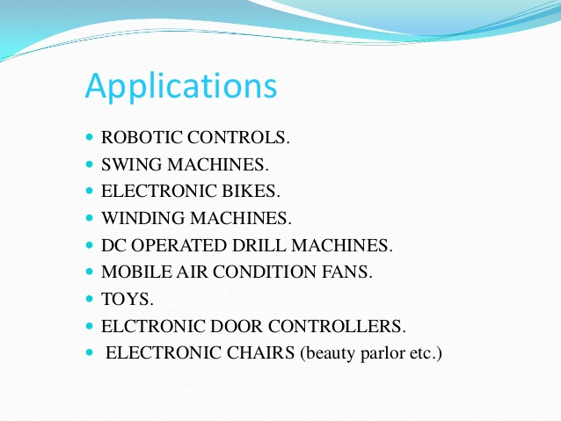

Slide 10


